Slide 1



GC Children’s Ministries
Reach A Child, Reach The World

Slide 2
Our Mission
To nurture children into a loving, serving relationship with Jesus

Slide 3
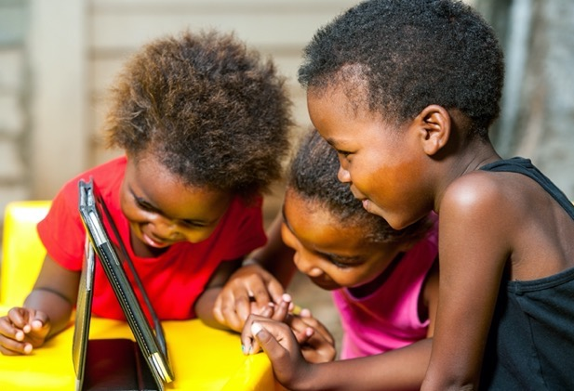

Strategic Plan Objectives
Mission Objectives
Spiritual Growth Objectives
Leadership Objectives

Slide 4


I. Mission
Objectives
1. To Foster a Lifestyle of Witnessing and Disciple-making in Children and Teens.
2. To Reach Children and Teens in the Huge Cities and the 10/40 Window.

Slide 5


II.
Spiritual Growth Objectives
To Help Children and Teens Grow Spiritually in Their Lives.
To Bring in More Children and Teens and Retain them in the Church by Involving Them.
To help youth and young adults place God first and exemplify a biblical worldview.

Slide 6

III. Leadership Objectives
To Strengthen Children’s Leaders and Teachers with Regular Growth Opportunities.
To align Children’s Ministries resources with the Church’s strategic objectives.
To enhance transparency, accountability, and credibility of denominational organization, operations, and mission initiatives.

Slide 7
Holy Spirit Objectives
Under the guidance of
the Holy Spirit, the
Church will work
together to fulfill these objectives

Slide 8
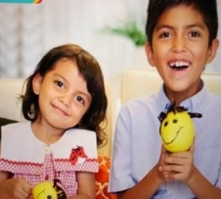
MISSION OBJECTIVES
#1
Key Performance Indicators (KPI)
KPI 1.1 Increased number of children and teens participating in both personal and public evangelism with a goal of Total Member Involvement.
Action Plan: Children to preach, present health talks, pray, greet visitors, read scripture, distribute tracts.
KPI 1.4 Create age-appropriate mission-focused morning devotional books aimed at each grade level of elementary education.
Action Plans: *Collaborate with FM, EDU, YM, & HM to develop mission-focused devotional book and other materials (print/digital).
*Promote use of mission animations & stories produced by Adventist Mission.
To revive concept of worldwide mission and sacrifice for
mission as a way of life involving every church member, young and old, in the joy of witnessing for Christ and making disciples

Slide 9

Objective #2
To strengthen and diversify Adventist outreach in large cities, across the 10/40 Window, among unreached and under-reached people groups, and to non-Christian religions
KPI 2.5 GC departments facilitate, initiate, and liaise between interdivisional mission projects, with active support from division and union leadership.
Action Plans: *GC CHM & division CHM directors to work with officers of the division and union levels to support mission project to reach children in the cities and the 10/40 Window.
*Work with unions in Kenya to assist with the Street Children project.

Slide 10
KPI 2.8 Each GC department has programs in place to respond to global trends in immigration.
Action Plans: GC CHM collaborates with Mission to the Cities, EDU, YM, WM to develop resources to reach refugee children and teens.

Slide 11
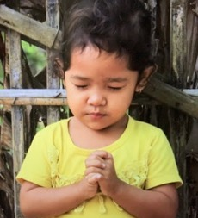
SPIRITUAL GROWTH OBJECTIVES
#5
Key Performance Indicators (KPI)
KPI 5.1 Increased number of children and teens regularly praying, studying the Bible, using the Sabbath School Bible Study Guides, reading the writings of Ellen White and engaging in other personal devotions.
Action Plans: *Encourage children to engage in TAG (Time Alone with God).
*Publish My Memory Verse Book and Coloring Book.
*Develop Armor of God APP for children with stories, animations, songs, and activities to help children learn about the 6 pieces of the armor.
*Revise a Bible studies series for children and teens.
*Develop a children’s website to upload children’s resources for them to use.
*Encourage children to read Ellen White’s books for kids
To disciple
individuals and
families into Spirit-
filled lives

Slide 12
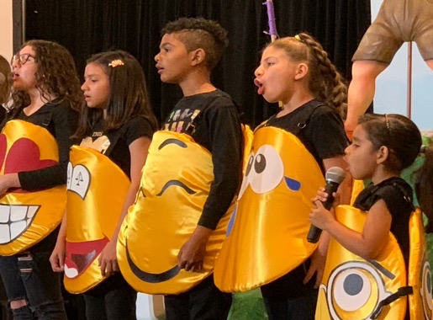
SPIRITUAL GROWTH OBJECTIVES
#5
Key Performance Indicators (KPI)
KPI 5.2 Significant increase in numbers of unbaptized children and youth attending church service and Sabbath School.
Action Plans: *GC CHM and division CHM provide regular children’s Sabbath School teacher training to equip them to run effective Sabbath Schools.
*GC CHM and division CHM collaborate with Ministerial Association to provide training for pastors and local church leadership in planning interesting and effective intergenerational worship services.
To disciple
individuals and
families into Spirit-
filled lives

Slide 13
SPIRITUAL GROWTH OBJECTIVES
#5
Key Performance Indicators (KPI)
KPI 5.3 Increase in acceptance and practice of church’s distinctive beliefs: Creation; Salvation by faith; State of Principles of healthful living; The Sanctuary; Second Coming; and other Fundamental Beliefs as Bible-centered doctrines that reflect a loving, gracious God.
Action Plans: *GC CHM develops health resources for children to teach them about the importance of living a healthy lifestyle:
-- CELEBRATIONS Health EXPO for Kids. (May 2021)
-- Beware of HIV/AIDS Comic Book and Music. (Nov ‘20) -- Exploring the Heart & Activity Book. (2022)
-- Suddenly A Tunnel & Activity Book. (2022)
To disciple
individuals and
families into Spirit-
filled lives

Slide 14
KPI 5.3
*GC CHM will work with GeoScience Institute to develop resources for children and teens to celebrate Creation Sabbath every October.
*Division CHM directors work with CHM leaders on the union levels to organize nature camps for children and teens that would help them appreciate God’s creation.
*GC CHM will print Creation Detectives comic book developed by the GeoScience Institute. (January 2021)
*GC CHM and division CHM directors promote the use of the animated series “Galapagos Island Adventures” produced by South American Division.
*GC CHM will produce 3 Angels Messages resources, such as stories and animations to teach children and teens about the end-time messages.

Slide 15

KPI 5.4 Increased number of children and teens using Adventist social media when studying the Bible, to learn about Ellen White and read her writings, in personal devotions, and to promote mission.
Action Plans:
*Recommend children & teens to use online Bible study, such as KidZone (VOP).
*Recommend children & teens to use God’s Messengers, Meeting Kids’ Needs an online study based on Ellen White’s counsels at http://whiteestate.org

Slide 16
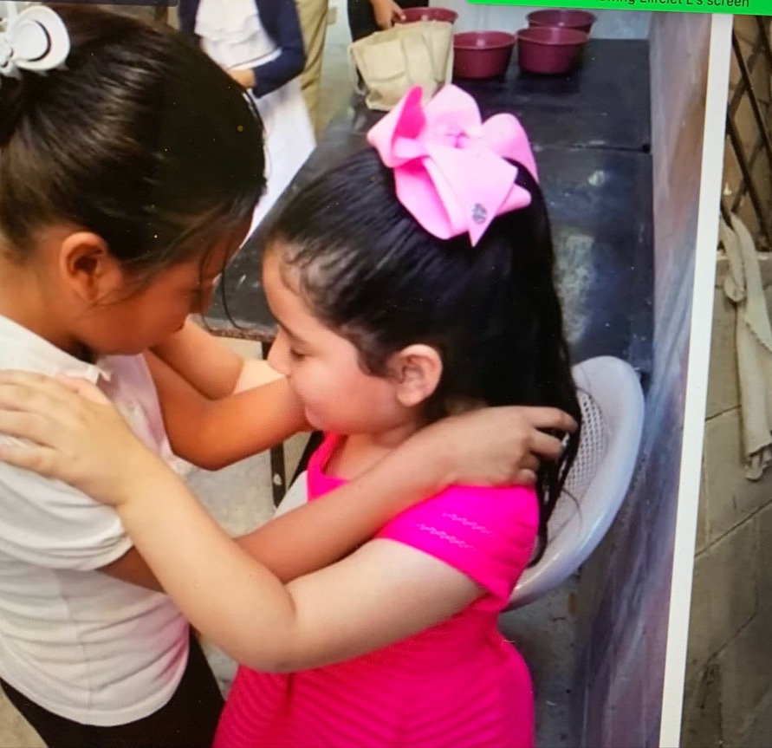
KPI 5.6 Increased number of children and church school students participating in corporate prayer initiatives
Action Plans:
*GC CHM will prepare the annual week of prayer readings for children that can be used by teachers and leaders to conduct week of prayers for children.
*Division CHM directors encourage the unions and conferences to organize prayer conferences for children and teens and engage them in the annual 10 Days of Prayer on the world church calendar.
*GC CHM will provide a yearly resource package for involving children in the World Day of Prayer for Children At-Risk
KPI 5.9 Increased number of children from Adventist homes and churches attending Adventist schools.

Slide 17
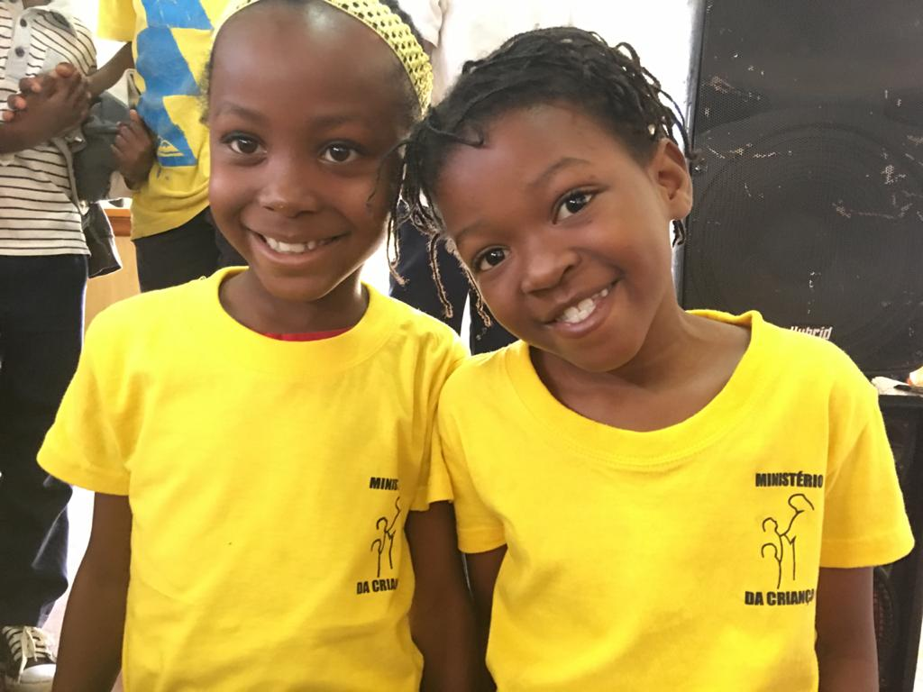
KPI 5.7 Evidence of better understanding of the prophetic role of Ellen White and the process of inspiration
Action Plans:
*GC CHM will collaborate with White Estate and Adventist ReviewTV to dub into
English the animation series “Nick’s Gift” produced by South American Division for
teaching children and teens about Ellen White. (September 2021)

Slide 18
KPI 5.8 Increased availability in local languages of Ellen White’s writings in print, braille, and audiobooks as well as on websites, mobile devices, and social media
Action Plans:
*GC CHM will collaborate with Christian Records to put Michael Ask Why, the children’s version of Ellen White’s Great Controversy, into braille.
*GC CHM will include sign language in the animation, “Nick’s Gift.”

Slide 19
KPI 5.9 Increased number of children from Adventist homes and churches attending
Adventist schools
Action Plans:
*GC CHM will prepare seminar presentations for use by the division CHM to help parents see the value of Adventist education.
*Division CHM directors will continue to encourage parents to send their children to Adventist schools, wherever possible.
*GC CHM provides resources for parents who do not send their children to church schools for reasons of finances, distances, or absence of Adventist schools, with tips on faith-building for their children who attend public schools. (2022)

Slide 20
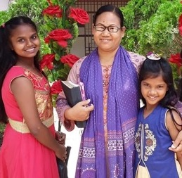
SPIRITUAL GROWTH OBJECTIVES
#6
Key Performance Indicators (KPI)
KPI 6.1 Increased children’s & teens’ involvement in fellowship and service, both in the church and in the local community.
Action Plans:
*GC CHM and division CHM directors recommends to union, conference, mission, and even local church children’s leaders to collaborate with Youth Ministries to organize activities to involve children and teens in regular community service projects.
*GC CHM will develop a Global Children’s Day postcard each year with activities, ideas, and suggestions for children to participate in community service. (March 2021, 2022, 2023, 2024, 2025)
*Division CHM directors to support their counterparts as they engage children in Global Children’s Day outreach services.
To increase accession, retention, reclamation,
and participation of
children, youth, and
young adults.

Slide 21
KPI 6.2 Evidence of greater unity and community among church members, of reduced conflict in local churches, and of an active commitment to zero tolerance of physical, emotional, and sexual abuse.
Action Plans:
*GC CHM and division CHM directors provide training on child sexual abuse for all children’s leaders who work with children.
*Division CHM directors work with churches to ensure that they screen & do background checks on volunteers who work with children.
*GC CHM provides division CHM leaders with the policy documents of Adventist Risk Management.
*GC CHM develops resources, both print and digital, to teach children about sexuality, how to avoid abuse situations, recognition of unhealthy touches, etc.; and will also share resources developed by Adventist Risk Management pertaining to this topic.
*GC CHM and division CHM directors provide training for parents, pastors, and church members on the types of abuse adults inflict on our children such as physical, emotional, and sexual.
*GC CHM and division CHM directors continue to promote the participation of churches in the annual Enditnow Sabbath every August.

Slide 22
KPI 6.3 Evidence of new members being nurtured through active discipleship programs
Action Plans
*GC CHM continues to provide training in Kids in Discipleship for the world divisions as well as financial subsidies to help with printing the Footprints for Parents & Footprints for Kids training manuals whenever possible.

Slide 23
KPI 6.4 Significant increase in number of families regularly engaging in family worships.
Action Plans:
*GC CHM will collaborate with FM, EDU, and YM to produce resources for conducting interesting family worships.
*GC CHM will develop one course on family worship for every level of the Leadership Certification. (2021, 2022, 2023, 2024, 2025)
GC CHM will launch the new Bible Story Felt APP in February 2021 for parents and children to use with family worships and Bible story time.

Slide 24
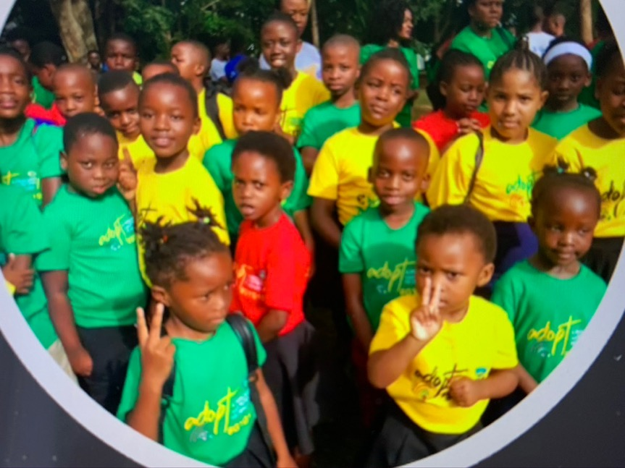
Action Plans
*GC CHM will collaborate with Stewardship Ministries to produce a resource package, Mini Stewards & short videos to teach children and teens about stewardship.
*GC CHM will collaborate with Stewardship Ministries to purchase and distribute 5,000 stewardship bags to the divisions for children and teens to learn the practical aspects of stewardship.
*GC CHM and Division CHM directors provide training seminars for children and teens on how to use their time wisely with their gadgets.
KPI 6.5 Children and teens embrace and practice stewardship principles regarding time, spiritual gifts, and tithes and offerings

Slide 25
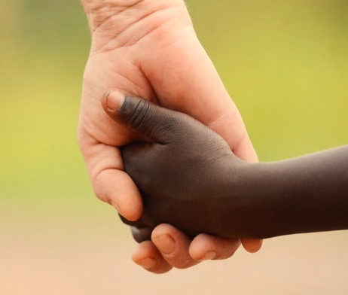
Action Plans:
* GC CHM will collaborate with YM, EDU to develop resources to teach children and teens about respecting different cultures, races, and nationalities. (2022, 2023)
*GC CHM and division CHM directors provide seminars/webinars for parents and children’s leaders on teaching their children tolerance and understanding of people of different races.
KPI 6.6 Church members exhibit cross-cultural understanding and respect for all people

Slide 26
SPIRITUAL GROWTH OBJECTIVES
#7
Key Performance Indicators (KPI)
KPI 7.2 Youth and young adults embrace the belief that the body is the temple of the Holy Spirit, abstaining from alcohol, tobacco, recreational use of drugs and other high-risk behaviors, and embrace church teachings on marriage, and demonstrate sexual purity.
Action Plans
*GC CHM will collaborate with HM to develop resources to teach children and teens learn about the dangers of alcohol, tobacco, and drug use.
To Help Youth and Young Adults Place God First & Exemplify A Biblical Worldview.

Slide 27

KPI 7.3 Increased ethical and responsible use of media platforms by students
Action Plans
*GC CHM will collaborate with FM, YM, and EDU to develop resources, both print and digital, for training children and teens on the responsible use of media.

Slide 28
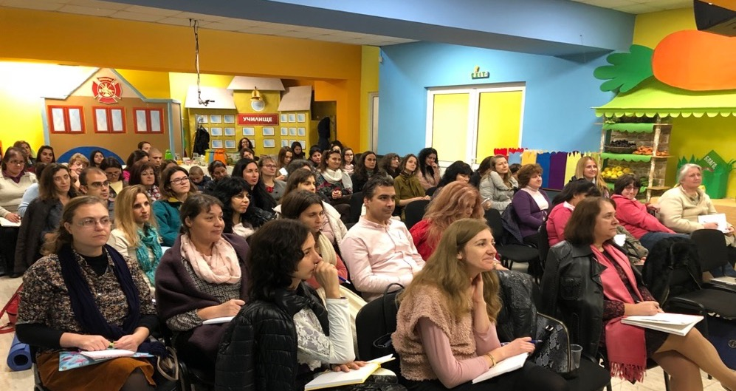


LEADERSHIP OBJECTIVES
#8
Key Performance Indicators (KPI)
8.1 Evidence that most children’s teachers feel supported by church members and leadership and are engaging in continuing education and development
To Strengthen the Discipleship Role of Pastors, Teachers, and Other Frontline Workers and Provide Them with Regular Growth Opportunities
Action Plans
*GC CHM will continue to produce one level per year of the Leadership Certification Course for training children’s leaders and teachers on all levels of the church.

Slide 29
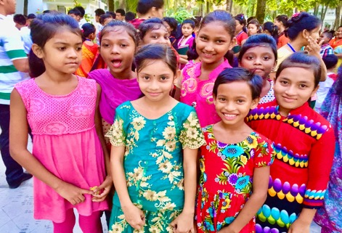
LEADERSHIPOBJECTIVES
#9
Key Performance Indicators (KPI)
9.2 All GC departments increase the availability of their time and resources to the 10/40 Window, large urban areas, and unreached people groups.
Action Plans
*GC CHM will provide more training resources for the 10/40 Window areas and urban cities.
*GC CHM and division CHM plan more training events in countries in the 10/40 Window and large urban cities.
To align world church
resources with strategic objectives

Slide 30
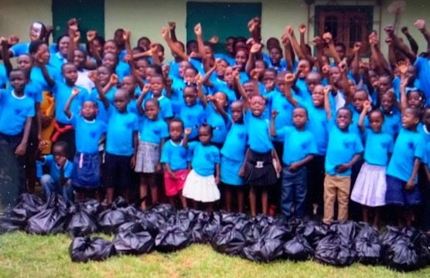
LEADERSHIPOBJECTIVES
#10
Key Performance Indicators (KPI)
10.5 Quinquennial reports of GC departments, institutions, and agencies to Annual Council focus on their contribution to achieving the objectives and KPIs of the I Will Go plan
Action Plans:
*GC CHM will provide a quinquennial report to the Annual Council of the extent to which the objectives and the KPIs of I Will Go initiative has been achieved.
To enhance transparency, Accountability, and Credibility of Denominational Organization, Operations, and Mission Initiatives.

Slide 31


